Slide 1
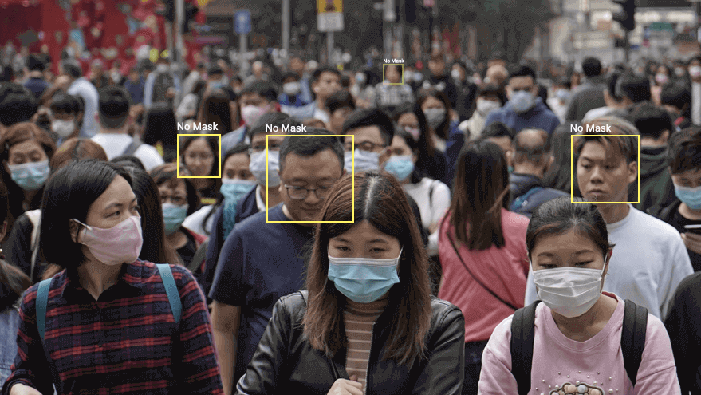
Problem

Slide 2
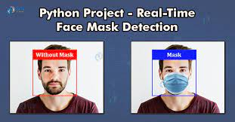
Solution
I decided to build a very simple and basic Convolutional Neural Network (CNN) model using TensorFlow with Keras api and OpenCV to detect if a person is wearing mask or not.

Slide 3


Slide 4
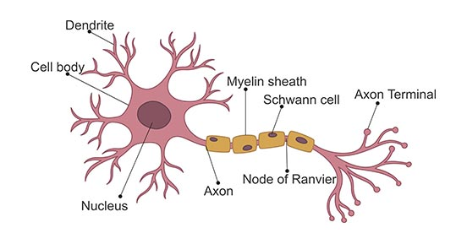
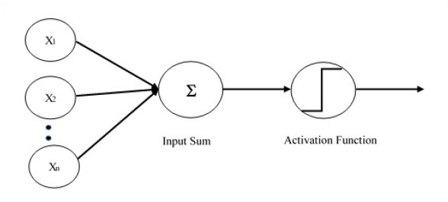
In deep learning, a convolutional neural network (CNN, or ConvNet) is a class of artificial neural network, most commonly applied to analyze visual imagery.
Neuron
Perseptron

Slide 5
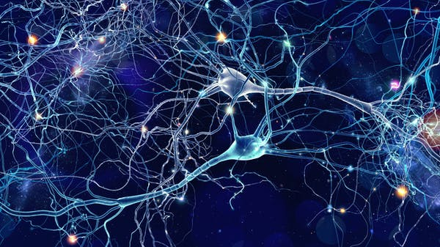
Actual Human Brain with millions of neuron’s connected to each other.

Slide 6
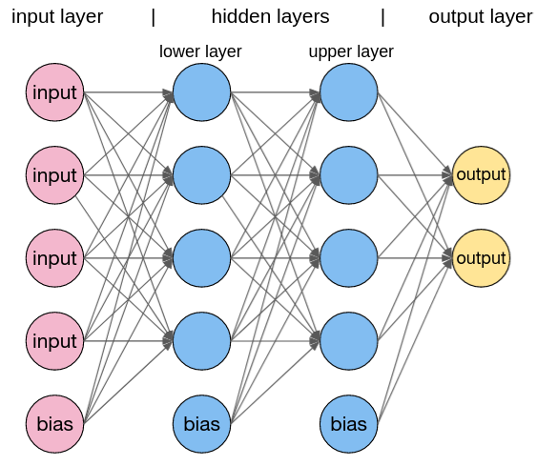
What we are going to do.
This is called Multi Layered Perceptron or MLP.
.

Slide 7
This can also be used to detect any object.

Slide 8
Project Walkthrough
1. Collecting Dataset
2. Data Pre-processing
3. CNN architecture development, training, and testing
4. Model deployment for live webcam feeds

Slide 9
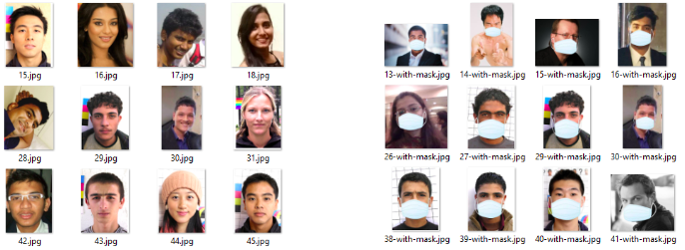
Collecting Dataset
In our case we want images of people with and without mask.This data can be found in kaggle.

Slide 10
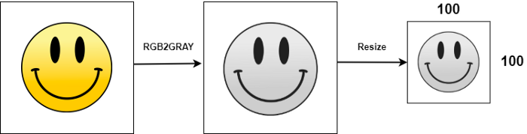
Data Pre-processing
By Default Images has multiple channels which is not required and can take high computational power, so First, each image was converted from RGB (Red, Green, Blue) to a Grayscale image then rescaling it to 224x224.

Slide 11
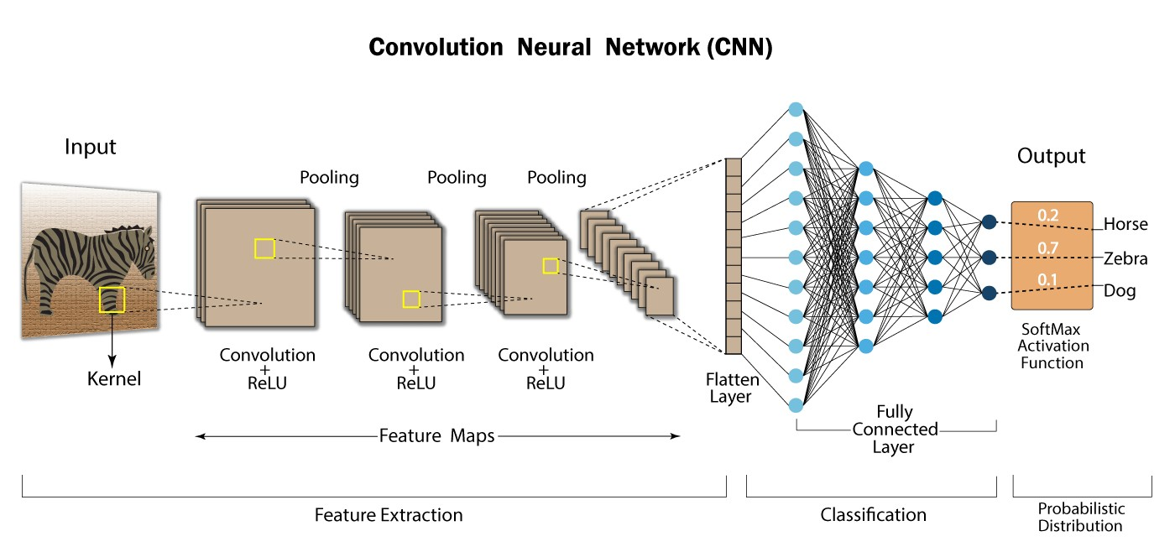
CNN architecture development, training, and testing

Slide 12
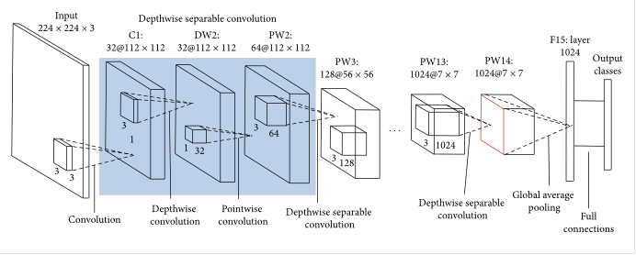
How MobileNet works
MobileNet, trained on ImageNet dataset.

Slide 13
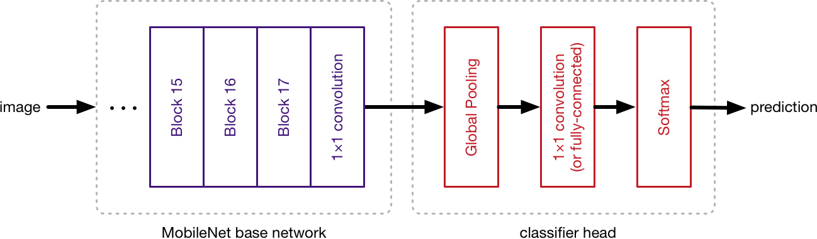
CNN architecture development, training, and testing
We are going to add our own layer of classifier on top of MobileNet.

Slide 14
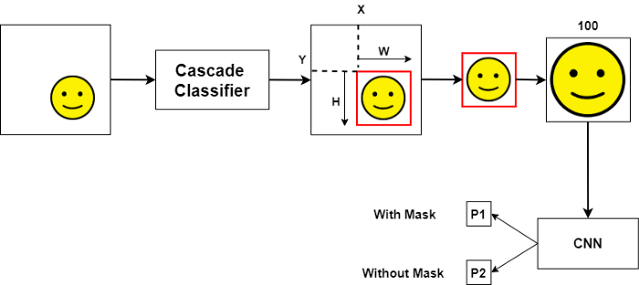
Model deployment for live webcam feeds
Images from Camera contains a lot of extra information than a simple Face.

Slide 15
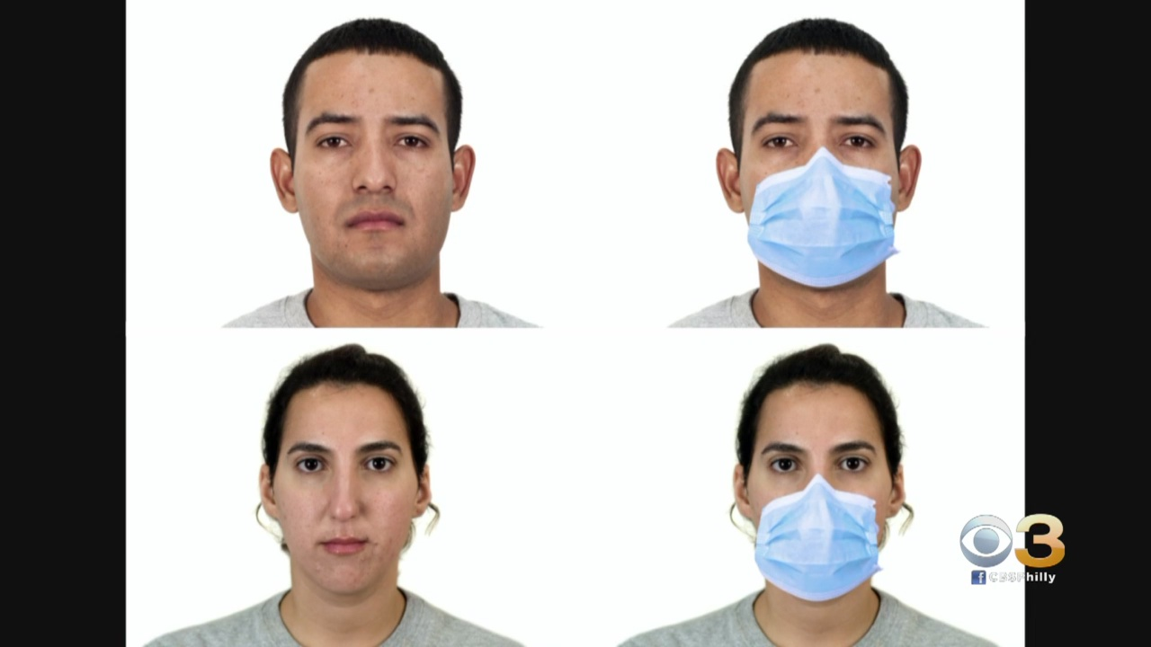
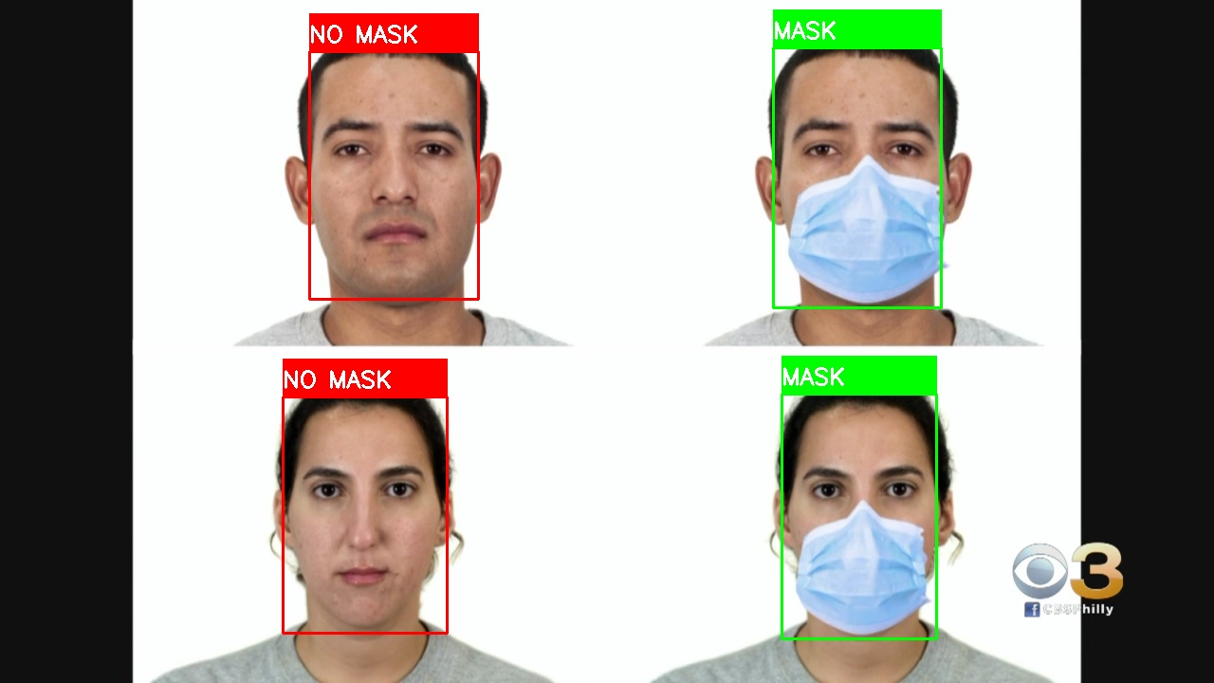
Result

Slide 16
References
Tensorflow
Keras API
MobileNet Research Paper https://arxiv.org/abs/1704.04861
OpenCV

